Slide 1
DESIGN THINKING
TAKSANDE SANDEEP RAVINDRA
PRN: 20020845030

Slide 2
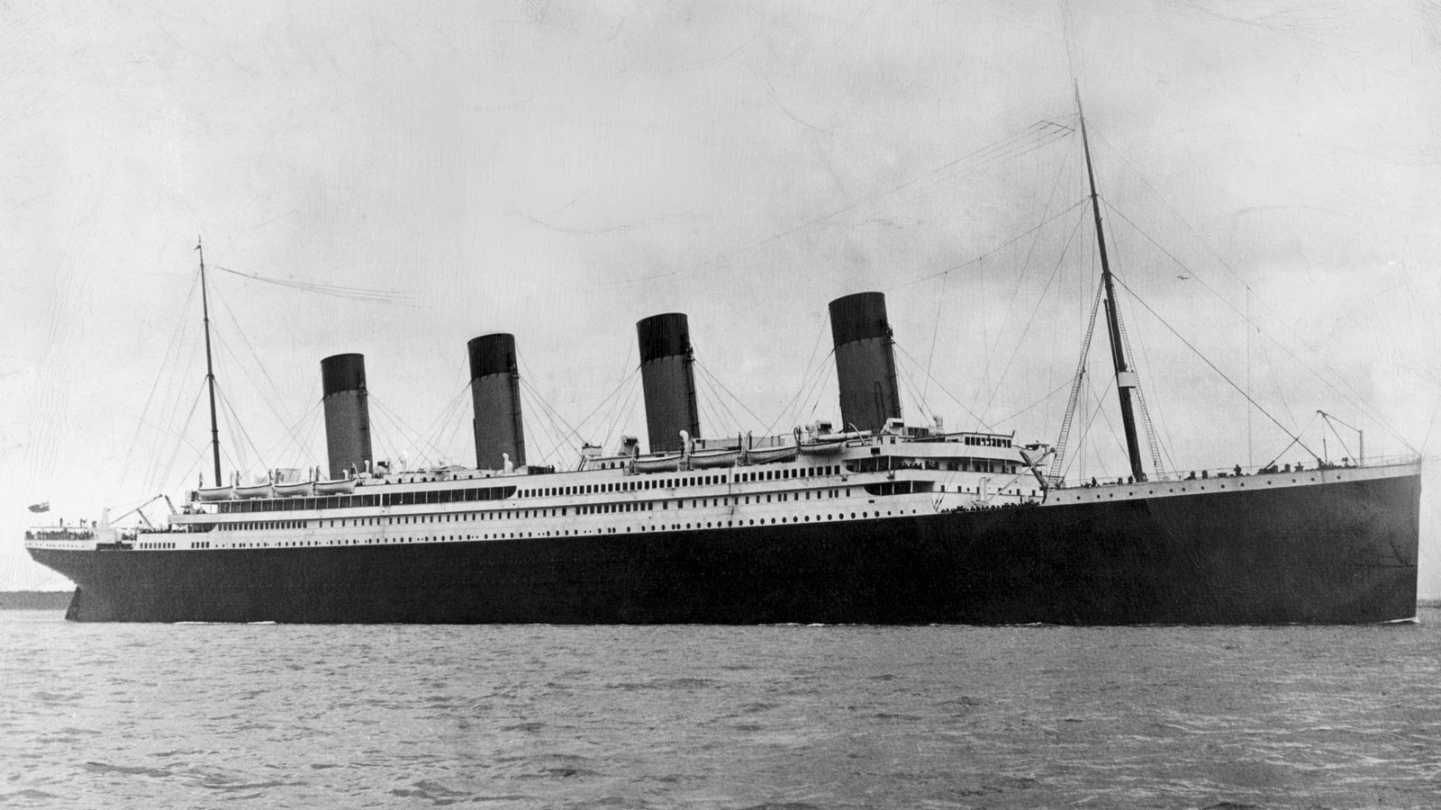
TITANIC
ABOUT
Royal Mail Ship (RMS) Titanic was a British Passenger Liner Operated by White Star Line
Port of Registry Liverpool, UK. Length 269.1 m, Beam 28.2 m, Draught 10.5, 35 stories high.
The largest ship afloat at the time she entered service
Maiden Voyage on April 10, 1912 from Southampton, England to New York, United States.
Estimated passengers – 2224 and crew onboard

Slide 3
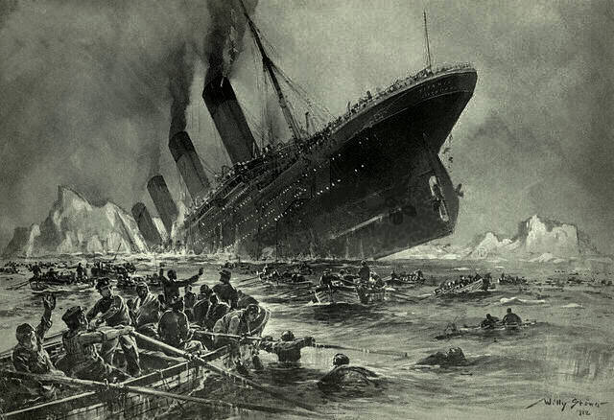
REASON FOR SINKING
Collision with the massive iceberg
On the night of April 14, Wireless operators received several ice warning for other ships in the area, Titanic continued to rush at nearly full steam.
By the time the Navigation Officer on watch noticed, iceberg was quarter a mile of the bow.
Engines were immediately thrown into reverse, rudder to hard port (Left side).
She sideswiped the iceberg damaging nearly 100 meters of the starboard (Right) side.

Slide 4
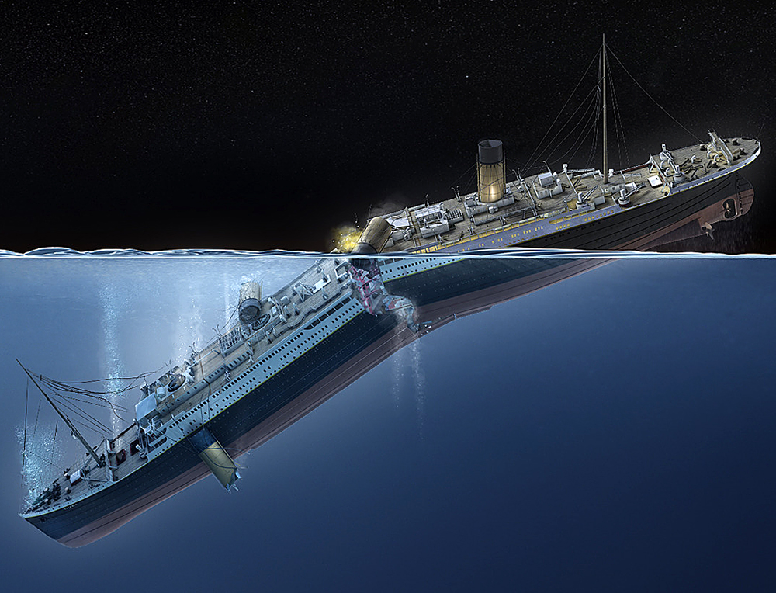
EFFECT
Damage allowed water to flow into six of the sixteen major water tight compartments.
Water rushed into starboard side of the ship’s bow, ship began to tilt down in front right.
When the ship was almost 45 degrees, stress in the mid-section increased and she broke from the middle.
Took less than 3 hours to sink
More than 1500 deaths, Only 705 passengers survived

Slide 5
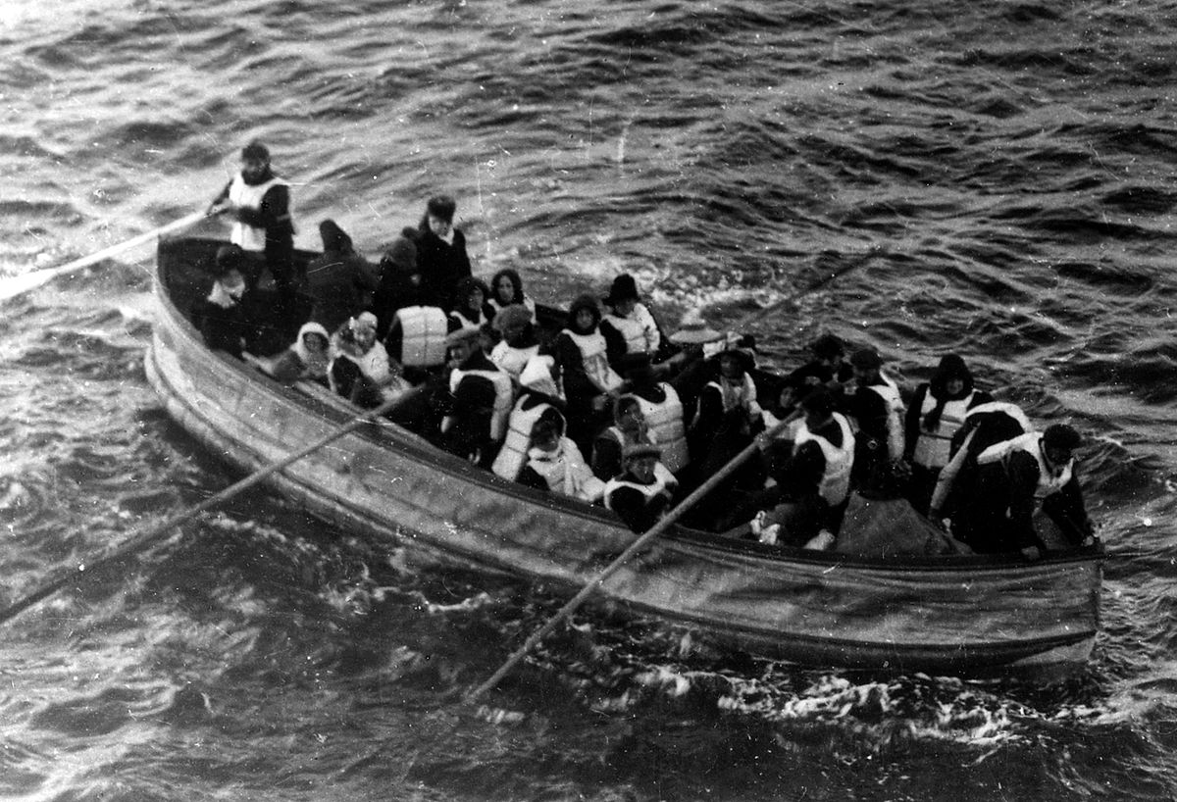
SAFETY CONCERN
Double Hull – only 16 hatches – Bad quality of steel
Limited Life Boats : 20 (Sufficient for 1178 people only) – 14 standard lifeboats having capacity of 65 each
Open Life Boats, manual operated
No Water Tight Doors in Engine spaces.
No proper Escape/ Evacuation Plan
“No Power Backup”

Slide 6
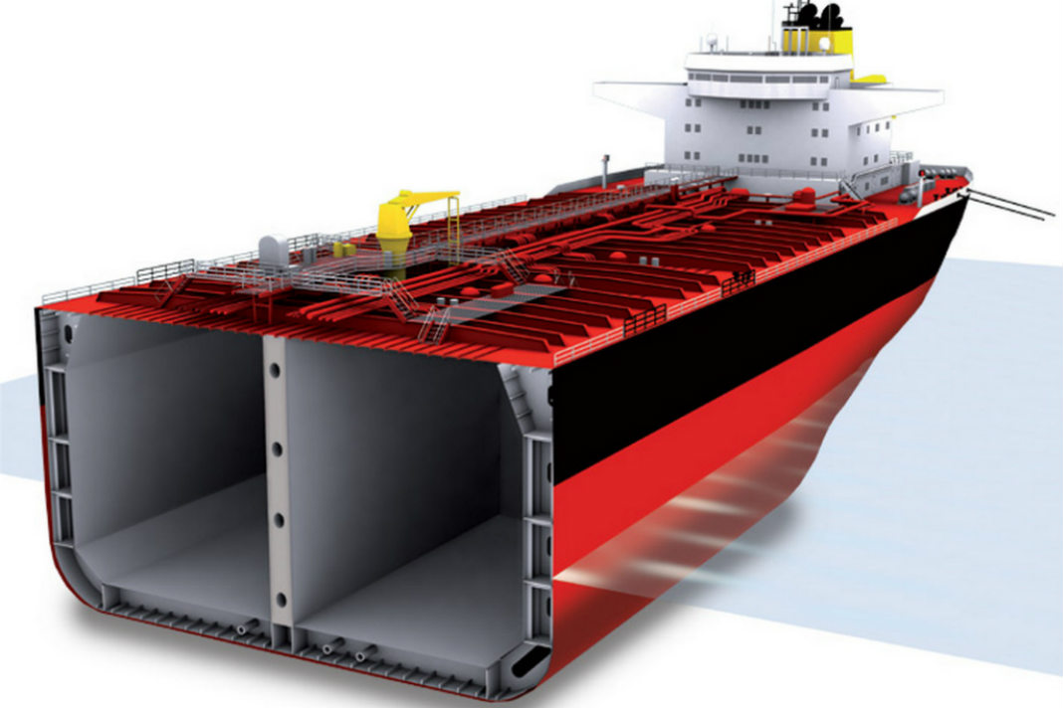
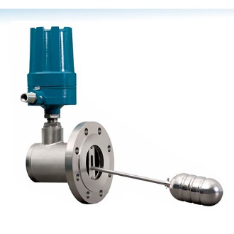
DESIGN THINKING
Bulkheads were made higher so water could not get in.
Double Hull Design – No of Hatches depends on the size and design of the ship.
Water/ Bilge Level Sensors for every hatch.

Slide 7
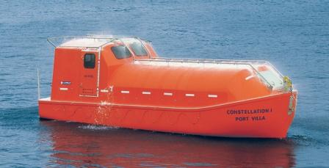
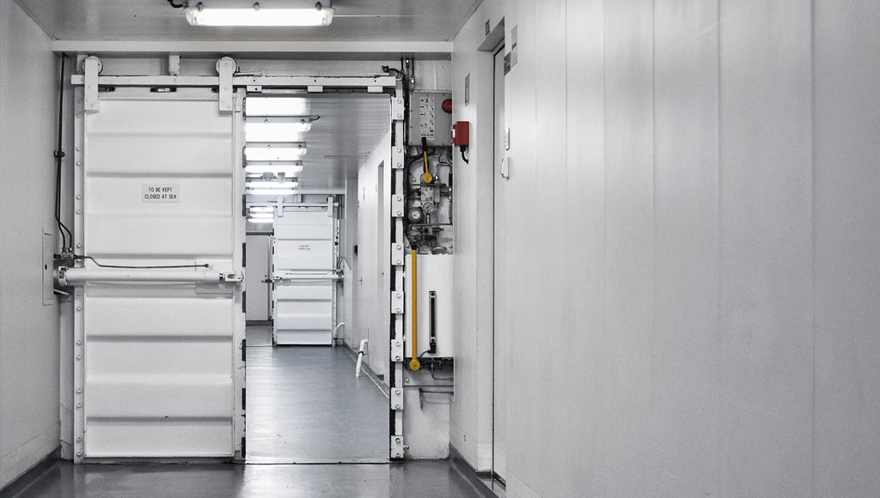
DESIGN THINKING
Lifeboats as per the capacity (100% capacity on both port and starboard lifeboats).
Semi Enclosed/ Closed Life Boats with sprinkler system, Diesel Engine Operated, equipped with Food and pyro techniques.
Water Tight Doors in Engine spaces operating from both Engine room and the Wheelhouse

Slide 8
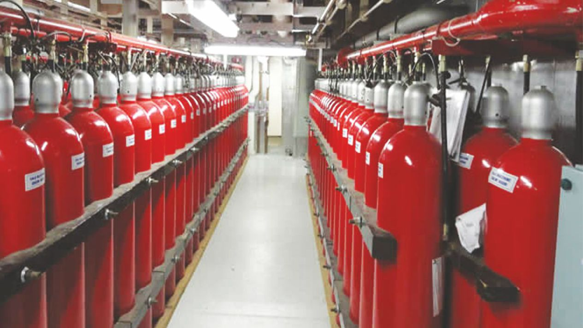
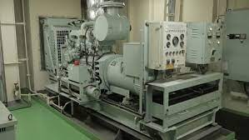
DESIGN THINKING
CO2 extinguisher System for Main Engine/ Steering Room/ Generators
Proper Evacuation Plans (Ships plan near both lifeboats)
Emergency Generator (located at the upper deck, accessible to anyone, source for all emergency equipment like fire pump/ GMDSS/ GPS/ Emergence Steering/ Gyroscope)

Slide 9
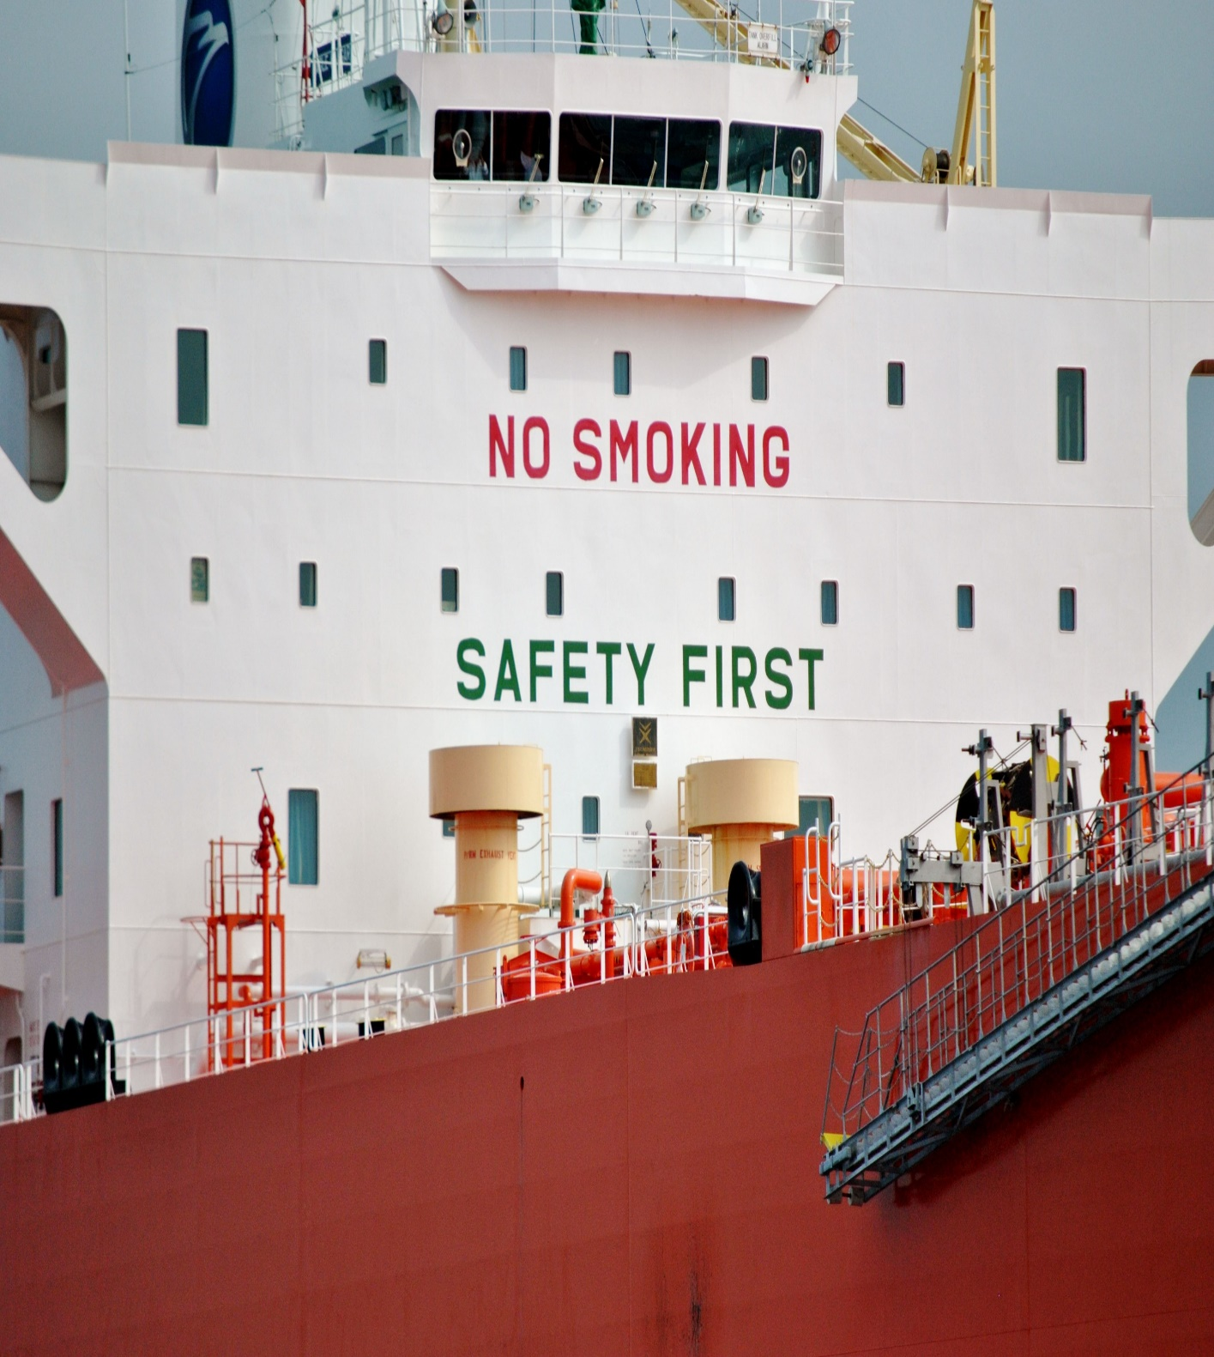
SAFETY FIRST
Fire/ Man Overboard/ Abandon Ship Drills are carried out at regular intervals.
100% of the passengers/ fresh crew to be familiarized with the vessel safety/ evacuation routes within 48 hours of the ship enroute and record to be kept by the Master.

Slide 10
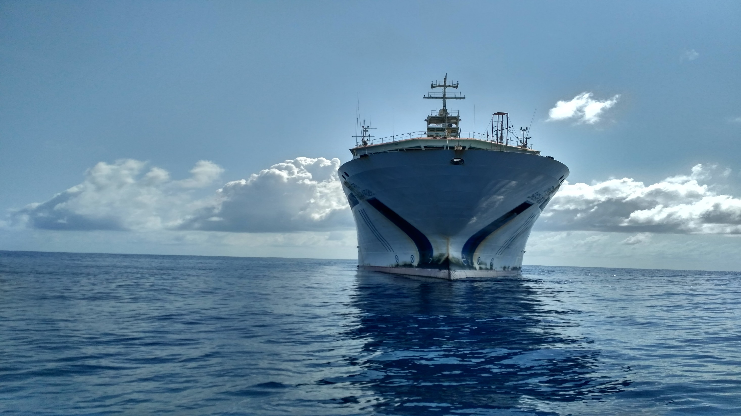
THANK YOU

